Slide 1

Auto-Generated Blog Posts with SEO Optimization: The Future of Content Creation

Slide 2



Why Auto-Generated SEO Content Matters in 2025
Massive Traffic Potential
Scalable Content Production
Accelerated Growth
Google processes over 8.5 billion searches daily; ranking high means massive traffic potential.
Manual content creation is time-consuming and costly; automation scales quality and quantity.
AI-driven SEO content creation accelerates ideation, drafting, and optimization—fueling growth.
In the rapidly evolving digital landscape, staying ahead means embracing innovative solutions. AI-powered content generation isn't just a trend; it's a strategic imperative for businesses aiming to capture market share and dominate search engine results.

Slide 3
The SEO Basics Automated by AI
Keyword Research: AI suggests relevant, high-potential keywords based on real search data, identifying opportunities you might miss.
On-page SEO: Titles, headings, meta descriptions, and keyword placement are optimized automatically, saving hours of manual tweaking.
Content Relevance: AI ensures blog posts closely match user intent and search queries, increasing engagement and reducing bounce rates.
Link Strategy: Internal linking and nofollow outbound links are managed to maximize SEO juice, boosting your domain authority.
AI takes the guesswork out of SEO, transforming complex tasks into streamlined, automated processes. This allows content creators to focus on high-level strategy and creative oversight.

Slide 4
Meet the AI Tools Powering Auto-Generated SEO Blogs
1
2
SEO.AI
Surfer SEO
Combines AI writing with data-driven SEO scoring and integrated optimization guidance for comprehensive content solutions.
Offers real-time content scoring and competitor analysis, ideal for crafting long-form blog posts that outrank the competition.
3
4
Wraith Scribe
Copy.ai
Focuses on generating comprehensive, relevant content and automating strategic nofollow links for maximum impact.
Provides rapid topic ideation and keyword validation, fueling scalable content pipelines with speed and efficiency.
These platforms represent the cutting edge of AI in content creation, offering diverse features to meet various SEO needs.

Slide 5
How AI Transforms the Blog Post Workflow
01
02
Ideation & Generation
Keyword Validation
Generate 30-50 blog post ideas tailored to your niche in minutes.
Validate and select top keywords using AI-powered tools like Ahrefs or SEMrush.
03
04
Drafting & Optimization
Refinement & Publishing
Auto-generate detailed content briefs and first drafts with SEO best practices baked in.
Refine and publish content with AI-assisted internal linking and meta tag automation.
This streamlined process significantly reduces the time and resources traditionally required for high-quality content production.

Slide 6
Real-World Impact: Traffic and Ranking Gains
"Daisie platform used AI-powered internal linking to boost traffic 60X!"
Comprehensive content correlates strongly with higher Google rankings (Backlinko study).
Faster content production means more frequent publishing, increasing domain authority.
— Case Study Insight
This demonstrates the transformative power of AI in achieving exponential growth in web traffic.

Slide 7

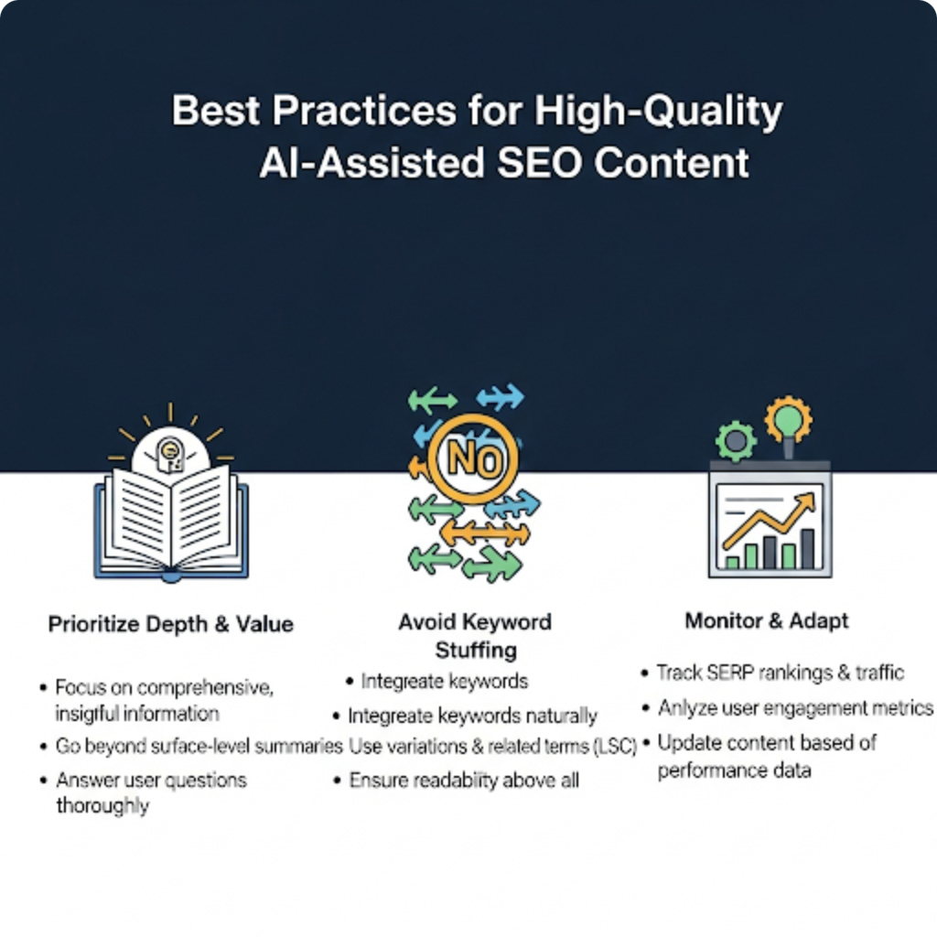
Best Practices for Auto-Generated SEO Content
Prioritize Quality: One well-crafted post beats multiple shallow ones. Focus on depth and value.
Natural & Engaging Content: Avoid keyword stuffing; ensure content reads naturally and captivates your audience.
AI as a Collaborator: Use AI as a powerful tool to assist, not replace, human creativity and oversight.
Monitor & Iterate: Continuously monitor performance with analytics and adapt your content strategy based on real user behavior.

Slide 8
Overcoming Challenges and Ethical Considerations
Avoid Blackhat Tactics
Fact-Check & Verify
Rely on proven, transparent optimization methods to build sustainable SEO. Authenticity is key.
Always fact-check AI-generated content to maintain credibility and build trust with your audience.
Balance Automation & Creativity
Stay Updated
Prevent mechanical, repetitive posts by infusing human creativity into the AI workflow.
Regularly adapt your strategies to new search engine algorithm changes to maintain relevance.
Navigating the ethical landscape of AI content ensures long-term success and a positive brand image.

Slide 9

The Future: AI + SEO = Smarter, Faster Content Marketing
Content Marketing
Search-Optimized Content
AI-Driven Content
Future Growth
Future Growth
AI
SEO
Integration with voice search and AI assistants requires conversational, question-based content.
Emerging AI tools will further personalize content for niche audiences and user intent.
Automation frees marketers to focus on strategy, storytelling, and conversion optimization.
The synergy between AI and SEO promises a future where content creation is not only efficient but also highly effective and deeply personalized.

Slide 10
Ready to Scale Your Blog with AI-Driven SEO?
Embrace AI Tools
Invest in Quality Content
Use Data-Driven Insights
Streamline ideation, writing, and optimization workflows.
Create comprehensive content that truly serves your audience.
Continuously refine and improve your SEO strategy.
The future of blogging is here—are you ready to lead the way?

